Slide 1
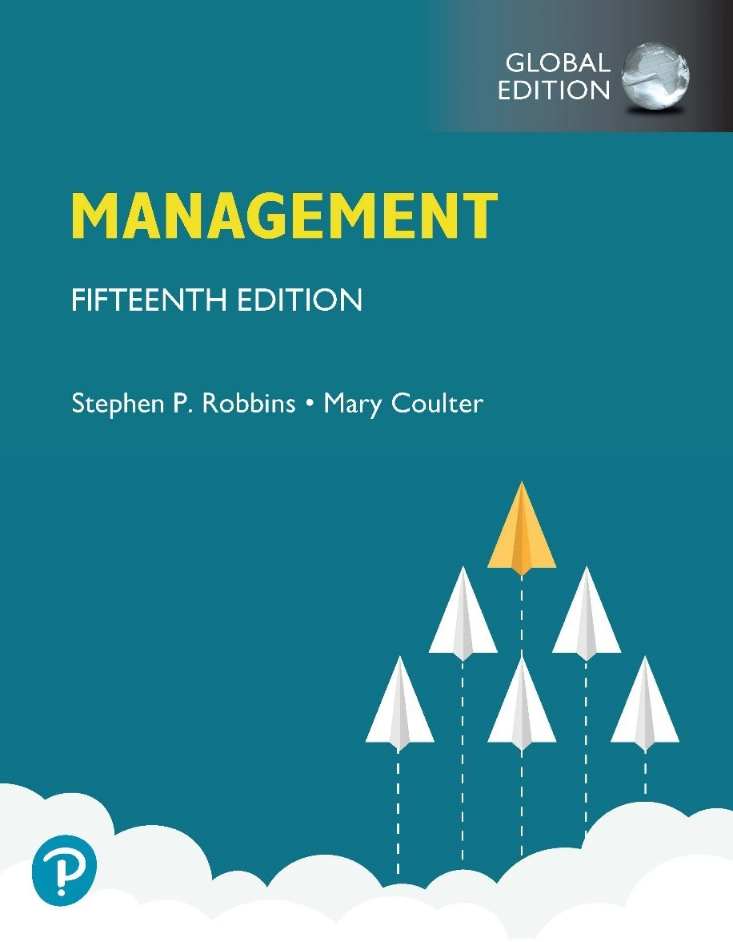
Management
Fifteenth Edition, Global Edition
Chapter 4
Managing in a Global Environment

Slide 2
Learning Objectives
Define globalization, nationalism, and parochialism; and contrast ethnocentric, polycentric, and geocentric attitudes.
Describe the history of globalization.
Summarize the case for and against globalization.
Explain the different types of international organizations.
Describe the structures and techniques organizations use as they go international.
Explain the relevance of the political/legal, economic, and cultural environments to global business.

Slide 3
What’s Your Global Perspective?
Globalization: the process of developing influence or operations in other countries
Nationalism: patriotic ideals and policies that glorify a country’s values
Parochialism: viewing the world solely through your own perspectives, leading to an inability to recognize differences between people

Slide 4
Three Possible Global Attitudes
Ethnocentric: view that home country has best work practices
Polycentric: view that managers in the host country know the best approaches
Geocentric: world-oriented view; wants to use best practices from around the globe

Slide 5
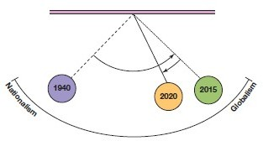
Exhibit 4.2 Nationalism vs. Globalism Pendulum
Exhibit 4.2 shows the timeline and general shifts in attitude between globalism and nationalism.

Slide 6
The Case for Globalization
The Win-Win Argument: The “every country wins” argument is based on the law of comparative advantage.
Essentially says a ‘rising tide floats all boats.’
Globalization benefits all trading partners.

Slide 7
The Case for Globalization Example
Country | Oil (barrels/day) | Wheat (tons/day)
Pakistan | 10 | 20
Saudi Arabia | 30 | 15
1: Find Opportunity Cost
Pakistan
1 oil = 2 wheat (because 10 oil vs 20 wheat)
1 wheat = 0.5 oil
Saudi Arabia
1 oil = 0.5 wheat (30 oil vs 15 wheat)
1 wheat = 2 oil
2: Identify Comparative Advantage
Pakistan → lower cost in wheat → comparative advantage in wheat
Saudi Arabia → lower cost in oil → comparative advantage in oil

Slide 8
The Case Against Globalization
The Downside of Globalization: Critics of globalization maintain that jobs were leaving developed high labor cost nations and flowing to cheap labor nations.
Cheap goods worldwide created wage stagnation for the middle class.
Globalization and capitalism together have increased wealth inequality.
Some groups are harmed by globalization.

Slide 9
The Case Against Globalization
1. Core Argument
Firms in countries like the United States or United Kingdom face high labor costs
To reduce costs, they shift production to countries like China, India, or Bangladesh
Result:
Job losses in developed countries
Job creation in developing countries
This process is often called offshoring or outsourcing:
Multinational firms relocate factories or services abroad
Example sectors:
Manufacturing (textiles, electronics)
Customer support / IT services

Slide 10
Real Example
Many US and European companies shifted textile production to Bangladesh …
Tech companies outsource customer service to India
➡ Workers in developed countries may lose jobs due to cheaper foreign labor

Slide 11
Globalization Today and Managerial Implications
Globalization will continue despite its critics because:
The infrastructure is already in place for global trade.
The evidence shows globalization is NOT the cause of unemployment—technology is the culprit.
Managers need to develop requisite skills to be a global manager.

Slide 12
How Organizations Go International
Global sourcing: purchasing materials or labor from around the world wherever it is cheapest

Slide 13
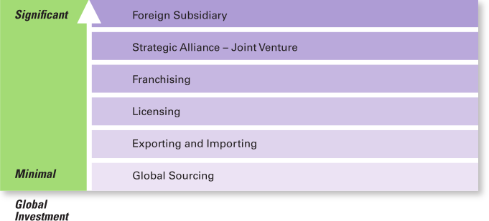
Exhibit 4.3 How Organizations Go Global
Exhibit 4.3 shows the different approaches companies can use to go global.

Slide 14
Going Global: Exporting and Importing
Exporting: making products domestically and selling them abroad
Importing: acquiring products made abroad and selling them domestically

Slide 15
Going Global: Licensing and Franchising
Licensing: an organization gives another organization the right to make or sell its products using its technology or product specifications
Franchising: an organization gives another organization the right to use its name and operating methods

Slide 16
Going Global: Strategic Alliances and Joint Ventures
Strategic Alliance: partnership between an organization and foreign company partner(s) in which both share resources and knowledge in developing new products or building production facilities
Joint Venture: A specific type of strategic alliance in which the partners agree to form a separate, independent organization for some business purpose

Slide 17
Going Global: Foreign Subsidiary
Foreign Subsidiary: directly investing in a foreign country by setting up a separate and independent production facility or office

Slide 18
Managing in a Global Environment
What challenges will a manager face in a new country?

Slide 19
Political/Legal Environment
U.S. managers are accustomed to a stable legal and political system
Managers must stay informed of the specific laws in countries where they do business
Some countries have risky political climates

Slide 20
Economic Environment
Free Market Economy: an economic system in which resources are primarily owned and controlled by the private sector
Planned Economy: an economic system in which economic decisions are planned by a central government

Slide 21
Cultural Environment
National Culture—the values and attitudes shared by individuals from a specific country that shape their behavior and beliefs about what is important.
Why It Matters
National culture directly influences:
Business practices and management styles
Workplace behavior and decision-making
Consumer preferences
International relations and communication

Slide 22
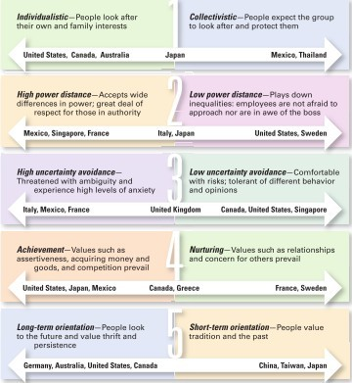
Exhibit 4.5 Hofstede’s Five Dimensions of National Culture
Exhibit 4.5 shows Hofstede’s Five Dimensions of National Culture.

Slide 23
Review Learning Objective 4.1 (1 of 2)
Define globalization, nationalism, and parochialism; and contrast ethnocentric, polycentric, and geocentric attitudes.
Globalization—a process by which organizations develop influence or operations in other countries.
Nationalism—patriotic ideals and policies that glorify a country’s values.
Parochialism—viewing the world solely through your own eyes and perspectives.

Slide 24
Review Learning Objective 4.1 (2 of 2)
Ethnocentric attitude—a parochial belief that the best work approaches and practices are those of the home country.
Polycentric attitude—managers in the host country know the best work approaches and practices for running their business.
Geocentric attitude—a world-oriented view that focuses on using the best approaches and people from around the globe.

Slide 25
Review Learning Objective 4.3
Summarize the case for and against globalization.
FOR Globalization: Based on the law of comparative advantage that states nations are better off focusing production on goods they can produce with the lowest opportunity cost and then engage in trade to get other goods. All nations benefit when this happens.
AGAINST Globalization: Globalization is responsible for wage stagnation in developed nations since low-wage countries now produce most labor-intensive goods. It also increases income and wealth inequality.

Slide 26
Review Learning Objective 4.5 (1 of 2)
Describe the structures and techniques organizations use as they go international.
Global sourcing: purchasing materials or labor from around the world wherever it is cheapest.
Exporting: making products domestically and selling them abroad.
Importing: acquiring products made abroad and selling them domestically.
Licensing: gives that organization the right to use the company’s brand name, technology, or product specifications.

Slide 27
Review Learning Objective 4.5 (2 of 2)
Franchising: use another company’s name and operating methods.
Global strategic alliance: partnership between an organization and foreign company partners
Joint venture: a strategic alliance in which the partners agree to form a separate, independent organization for some business purpose
Foreign subsidiary: direct investment in a foreign country that a company creates by establishing a separate and independent facility or office

Slide 28
Review Learning Objective 4.6 (1 of 2)
Explain the relevance of the political/legal, economic, and cultural environments to global business.
The laws and political stability of a country are issues in the global political/legal environment with which managers must be familiar
Managers must be aware of a country’s economic issues such as currency exchange rates, inflation rates, and tax policies.

Slide 29
Review Learning Objective 4.6 (2 of 2)
Geert Hofstede identified five dimensions for assessing a country’s culture: individualism-collectivism, power distance, uncertainty avoidance, achievement- nurturing, and long-term/short-term orientation.

Slide 30


